Slide 1
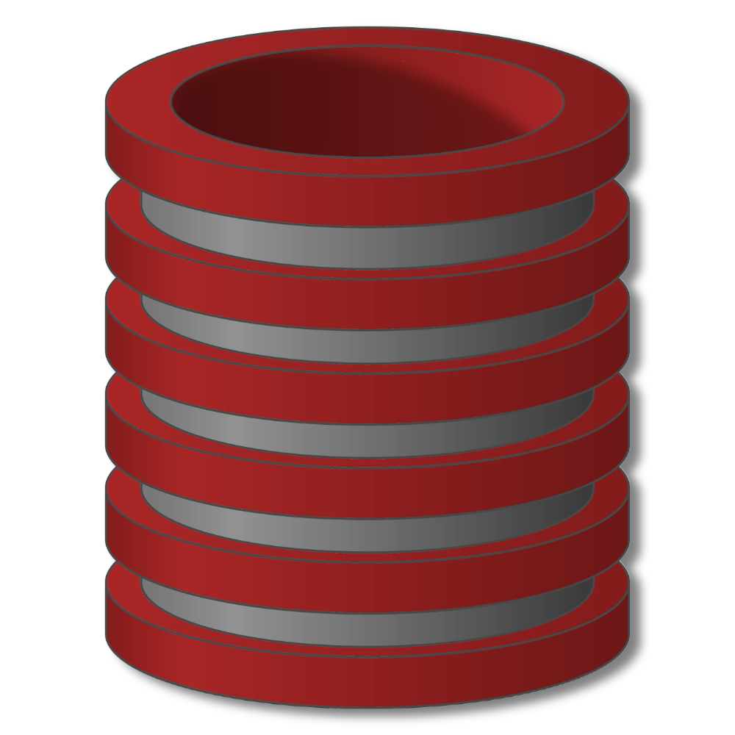
Views
View Modifications − Introduction

Slide 2
View Modifications: Intro
Why use views?
Hide some data from some users
Make some queries easier / more natural
Modularity of database access
Real applications tend to use lots and lots (and lots and lots!) of views

Slide 3
View Modifications: Intro
Querying views
Once V defined, can reference V like any table
Queries involving V rewritten to use base tables

Slide 4
View Modifications: Intro
Modifying views
Once V defined, can we modify V like any table ?
Doesn’t make sense: V is not stored
Has to make sense: views are some users’ entire “view” of the database
Solution: Modifications to V rewritten to modify
base tables

Slide 5
View Modifications: Intro
Modifications to V rewritten to modify base tables

Slide 6
View Modifications: Intro
Modifications to V rewritten to modify base tables
(1) Rewriting process specified explicitly by view creator
+ Can handle all modifications
– No guarantee of correctness (or meaningful)
(2) Restrict views + modifications so that translation to base
table modifications is meaningful and unambiguous
+ No user intervention
– Restrictions are significant

